Slide 1

Fuel Management System
A web-based system to manage fuel stations, transactions, inventory, pricing, and vehicle tracking efficiently.
Alfi Shahriar (0112320293)
Naima Islam nabila (0112320270)
Asia Kabir Shafa (0112320295)
Md. Sajid hasan (0112410166)
Anas Ahmed (0112410455)

Slide 2
Type of Project
Type: Web Application
Centralized fuel station management system
Accessible via browser
Supports admin and staff roles

Slide 3
Objectives
Manage fuel sales and transactions efficiently
Track fuel inventory across stations
Monitor vehicle fuel usage and odometer readings
Maintain fuel price history
Provide secure user and role management
Generate reports and audit logs

Slide 4
Problem Statement
Manual fuel tracking leads to errors and inefficiency
Difficulty in managing inventory across stations
Lack of proper monitoring of fuel consumption
No centralized system for price updates and history
Poor transparency in transactions and auditing

Slide 5
Deliverables
Real-time Fuel Inventory Tracking
Digital Token & Queue Management
Vehicle Type-Based Fuel Allocation
Supply Chain & Delivery Tracking
Transaction Log & Fraud Detection
Role-based Admin Dashboard & Reporting Fuel Pass
Employee Shift & Accountability Management
Dynamic Pricing & Price Change Log
Multi-pump Station Network & Availability Map
Automated Audit Trail & Regulatory Reporting
Odometer-Based Fuel Eligibility Verification

Slide 6
Methodology
Agile Development Approach
Iterative development
Continuous testing and feedback
Modular implementation:
Database design
Frontend UI
Integration

Slide 7
Entity-Relationship Diagram

Slide 8
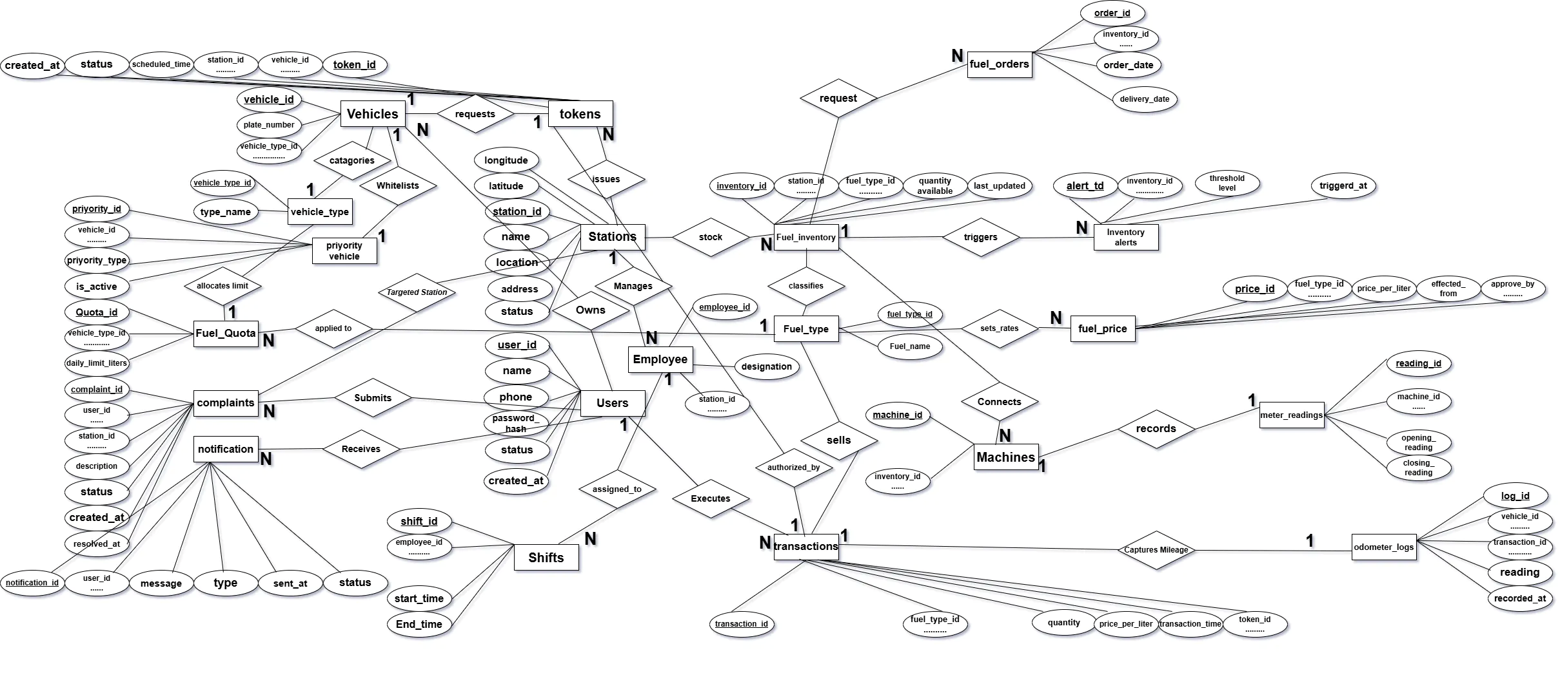

Slide 9
Entity-Relationship Schema

Slide 10
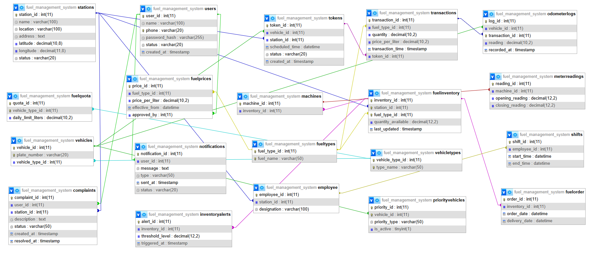

Slide 11
Technology Stack
Frontend:
HTML, CSS, JavaScript
(Optional: React)
Backend:
PHP
Database:
MySQL
Tools:
Git
VS Code
XAMPP

Slide 12
Risks and Dependencies
⚠ Risks:
Data inconsistency if constraints not enforced
System downtime
Incorrect user input
Dependencies:
Database server availability
Internet connection
Hosting environment

Slide 13
Conclusion
Provides a centralized and efficient fuel management solution
Improves accuracy, transparency, and tracking
Scalable for multiple stations and users
Suitable for real-world fuel station operations

Slide 14

Thank you
Presented By – Group_1
Created By Md. Sajid Hasan

